Slide 1
Veterans law clinic
Widener University School of Law

Slide 2
OUR MISSION
PROVIDE PRACTICAL LEGAL EXPERIENCE TO LAW STUDENTS AND LEGAL SERVICES TO LOW INCOME VETERANS

Slide 3
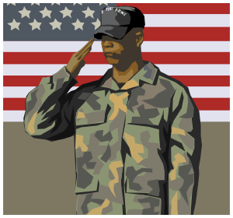
WHO ARE WE?
Widener Law School clinical program
Provide direct legal representation to veterans for
Appeals for denial of compensation benefits
Discharge upgrades
Other legal issues (i.e., expungement, landlord/tenant matters)
Provide social services resources and support

Slide 4
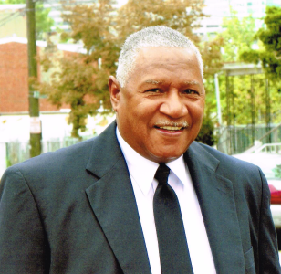
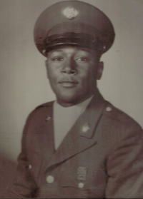
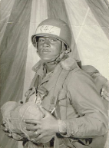
Who we help
Disabled veterans who have been denied compensation for an injury, disease or illness incurred while in service
Most are low income
Veterans from nearly every conflict and their families
Notes:
James Brown - Army, Vietnam 1965-1967

Slide 5
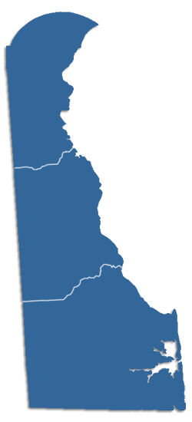
Veteran population
The VLC is situated in a region with a substantial veteran population.
As of 2013, the VA estimates that Pennsylvania, New Jersey and Delaware is home to almost 1.5 million veterans
Nearly 75% of whom are classified by the VA as “wartime” veterans.
(National Center for Veterans Analysis and Statistics, Sept. 30, 2013)

Slide 6
Clinic history & staff
Started in 1997
Became a law school clinic in 2005
Director, part time staff attorney, two full time EJW fellows, office assistant
Enrollment of 10 to 20 students per semester
Summer internship program

Slide 7
New at the clinic 2013-2014
MSW Program
Linking clients with VA services and community resources
Two MSW student interns from the Chester campus providing assistance in linking veterans to social services
Helping veterans with finding financial, medical and budgeting assistance, especially in linking veterans with therapy from the VA or other sources
Someone to help veterans deal with the frustration of the VA system
Equal Justice Works AmeriCorps Legal Fellows
Providing additional legal services to veterans
Matching grant funding from EJW to hire two recent law graduates to provide legal assistance to veterans in the area of compensation and pension issues, and other legal issues that are preventing stability in a veteran’s life including expungement, consumer issues and landlord/tenant matters.

Slide 8
Our successes
$5.2 million dollars in retroactive awards since inception of clinic
$1.2 million in 2012
$720,000 in 2013
Each one of these awards contains monthly benefits paid to the veteran and/or the veteran’s dependents.
These benefits help keep veterans out of poverty and to combat the threat of becoming homeless.

Slide 9
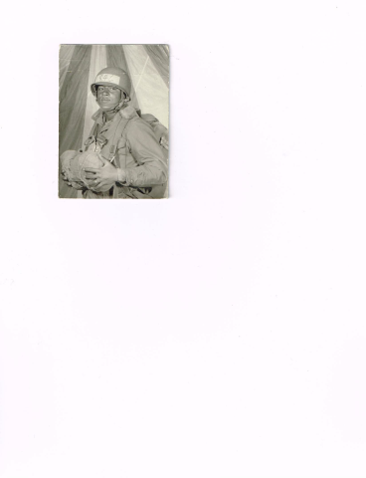
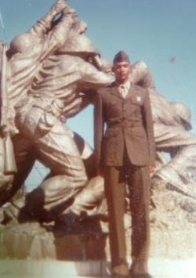
Favorable outcomes
JR originally filed his claim for PTSD/MST in 2000. VA denied benefits 6 times in 6 years (2000-2006).
2006 decision issued by VA Regional Office in Wilmington was appealed to the Board of Veterans Appeals (BVA).
The BVA remanded the VA’s decision; on remand JR was granted benefits for PTSD in May 2012 (was also granted TDIU).
Notes:
Jose Rodriguez – USMC 1979-1983, reserves until 1985. Filed claim for PTSD in 2000. Reported that he was the victim of numerous personal assaults during active service and contended that those assaults were the stressors that caused his PTSD. BVA remanded on issue of new & material evidence.

Slide 10
Pro bono program
VLC recruits, trains and fully supports all pro bono attorneys
Allows the clinic to assist more veterans
Volunteer attorneys are assigned to a veteran’s case and work on it with the support of the clinic as needed
Staff member will sit in on an initial appointment and will be assigned to assist the volunteer attorney with the case
Students are available to help with research and other tasks

Slide 11
Why should you help?
“The best thing that the Veterans Law Clinic does is to help the disabled veteran know that he is not abandoned. It’s been my privilege to serve someone who served, and, in a modest way, join him in struggles. Volunteering through the clinic allows you to keep the faith with an American, who, when we needed him or her most, kept the faith with us. It’s a rewarding representation, assisted every step of the way by the Veterans Law Clinic. I’m thankful for the experience.
James Haley, Jr./volunteer with the VLC
It has been an honor to serve as a volunteer attorney with the Veterans Law Clinic. I am proud of my family's tradition of military service, and working with the Clinic is a rewarding way to support a very worthy cause. I have gained insight into a new practice area and benefited from the opportunity to work closely with an experienced attorney in this subject. Serving as a volunteer attorney with the Clinic is a great way for a new attorney engaged in the employment search to maintain their legal research and writing skills while assisting others.
Jonathan Brandon/volunteer with the VLC (graduated from Penn State Dickinson School of Law 2012)

